Slide 1
Risk/Threat Assessment Location: Westmoreland State Park
Conducted by: MVX Security Solutions, LLC | Date: | Updated:

Slide 2
General Venue Information
Official Venue Name: Westmoreland State Park
Functional Description: Visitor’s Center Brown single story wooden structure with dark shingled roof.
Local Address:
Additional Information: Hours of operation from dusk until dawn. There was also a recent termination of a part time Park Ranger. There were hard feelings between either party.

Slide 3
Point of Contact Information
Primary POC Name:
Job Title: Assistant Park Manager | Nationality: American
Languages Spoken: English
Phone Number: | Email:
Alternate POC Name: N/A
Job Title: | Nationality:
Languages Spoken:
Phone Number: | Email:
Additional Information: The residence belonging to the Park Police are and will be off limits during the TSS & Advance (see attached photo)

Slide 4
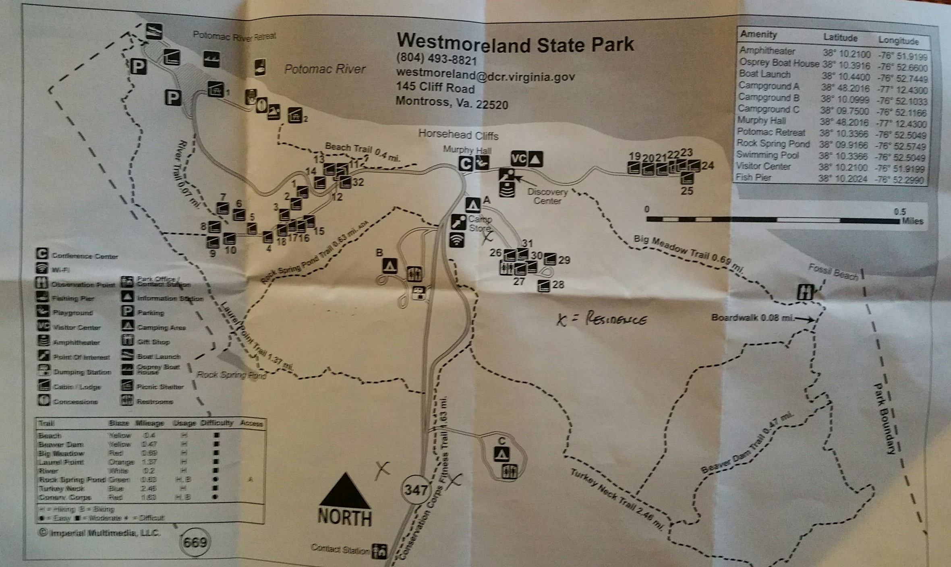
Point of Contact Information
Primary POC Name: Steve W. Davis
Job Title: Assistant Park Manager | Nationality: American
Languages Spoken: English
Phone Number: (804) 493-0587 | Email: Steve.Davis@dcr.Virginia.gov
Alternate POC Name: N/A
Job Title: | Nationality:
Languages Spoken:
Phone Number: | Email:
Additional Information: The residence belonging to the Park Police are and will be off limits during the TSS & Advance (see attached photo)
OFF LIMITS
OFF LIMITS

Slide 5
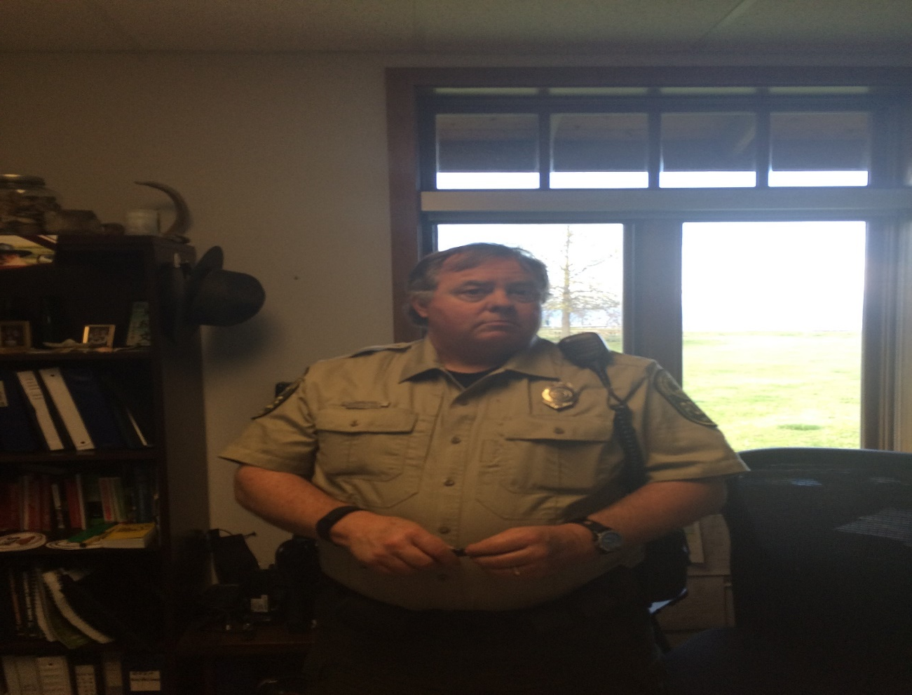
Point of Contact Information John Doe

Slide 6
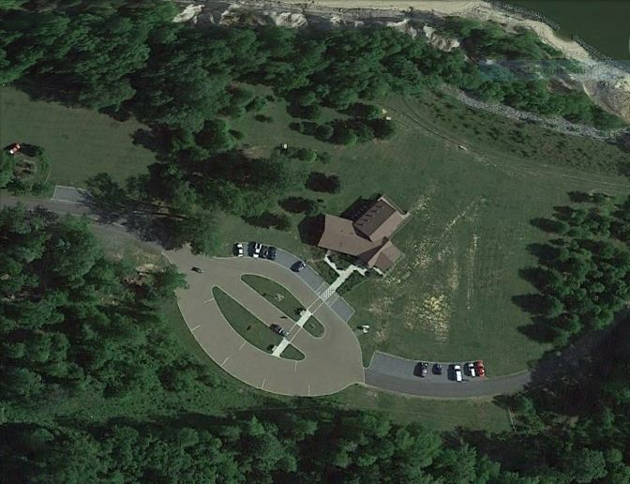
Grounds/Compound Overlays Google Earth Imagery, Perimeter Outline, Compound Sketch Overview
Description: Overhead of Westmoreland State Park
GOOGLE & FALCONVIEW IMAGERY

Slide 7
Grounds/Compound Overlays Google Earth Imagery, Perimeter Outline, Compound Sketch Overview
Description: Overhead of Westmoreland State Park
Primary Drop site

Slide 8
Perimeter
Perimeter Description: Grassy area surrounded by trees and a cliff on the rear side of the venue.
Primary Ingress/Egress Point Description: Primary ingress & egress is a two lanes black top (sometimes separated by grassy medians) surfaced road with signage and a guard shack at the half way point, from the main road to the venue.
Location: | Vehicle Access: Yes | Pedestrian Access: Yes
Control Point Description: Control point is a red wooden guard shack positioned at a fork in the road at the half way point from the main road to venue. It has one door and two windows. No drop arm.
Alternate Ingress/Egress Point Description: N/A
Location: N/A | Vehicle/Bearcat Access: | Pedestrian Access:
Control Point Description (drop arms, chicanes, tire poppers, gate, metal detectors, etc.):
Tertiary Ingress/Egress Point Description (can a Bearcat pull up to and or back up to?):
Location: | Vehicle/Bearcat Access: | Pedestrian Access:
Control Point Description (drop arms, chicanes, tire poppers, gate, metal detectors, etc.):

Slide 9
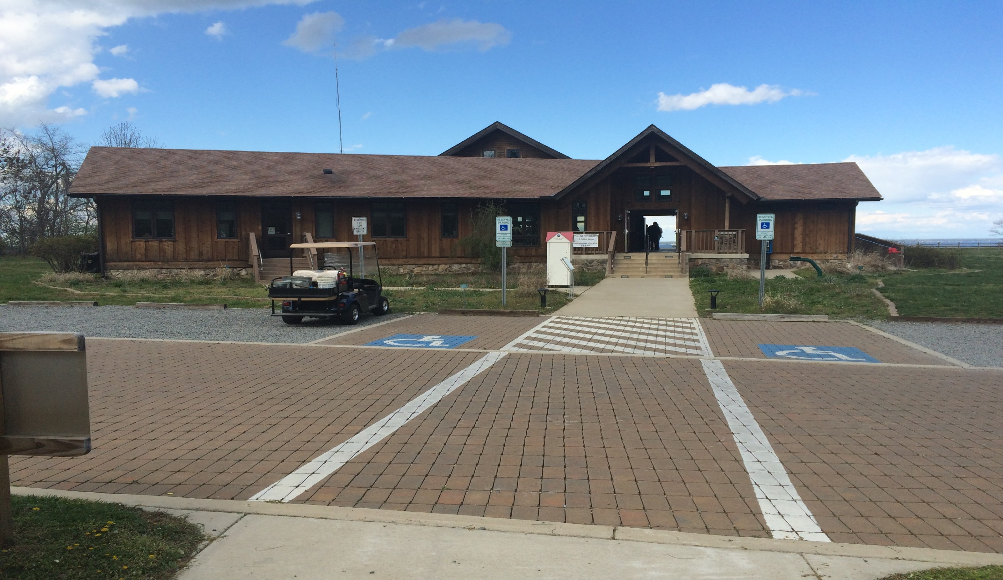
Exterior Survey Supporting Graphics Compound Sketch (Dir. Of Travel, Order of Movement), Annotated Drop Points, Venue Meeting Room, Ingress/Egress, Parking/HLZ, Bunker Array etc…
Description:
PICTURES OF EXTERIOR
INCLUDE CAC, DROP POINT, ETC..

Slide 10
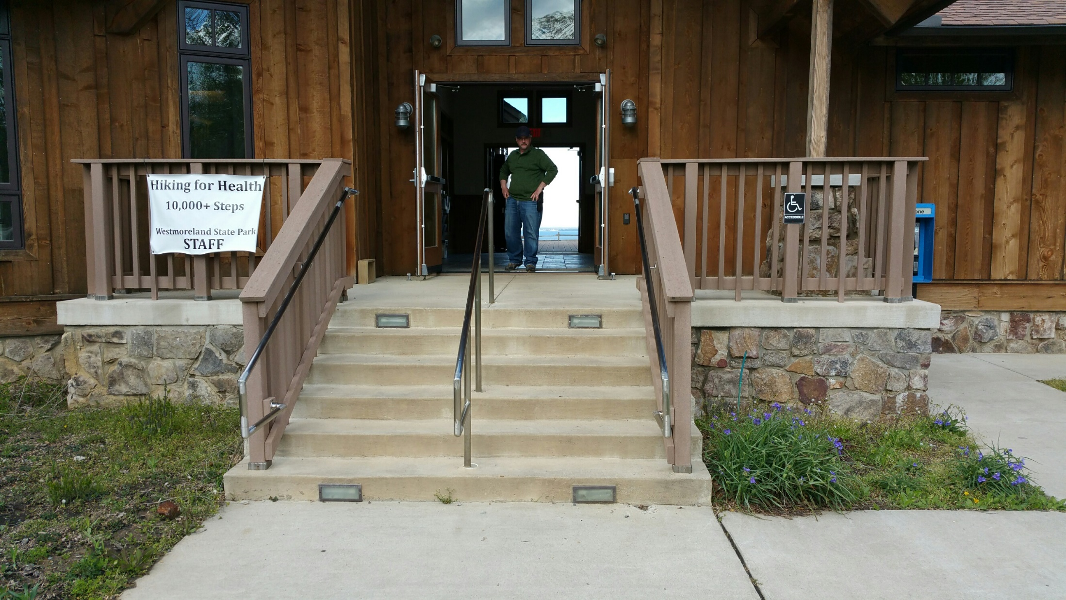
Exterior Survey Supporting Graphics Compound Sketch (Dir. Of Travel, Order of Movement), Annotated Drop Points, Venue Meeting Room, Ingress/Egress, Parking/HLZ, Bunker Array etc…
Description:
PICTURES OF EXTERIOR
INCLUDE CAC, DROP POINT, ETC..

Slide 11
Exterior Survey Supporting Graphics Compound Sketch (Dir. Of Travel, Order of Movement), Annotated Drop Points, Venue Meeting Room, Ingress/Egress, Parking/HLZ, Bunker Array etc…
Description: B003
PICTURES OF EXTERIOR
INCLUDE CAC, DROP POINT, ETC..
HLZ
Grid
18S UH 36765 26336

Slide 12
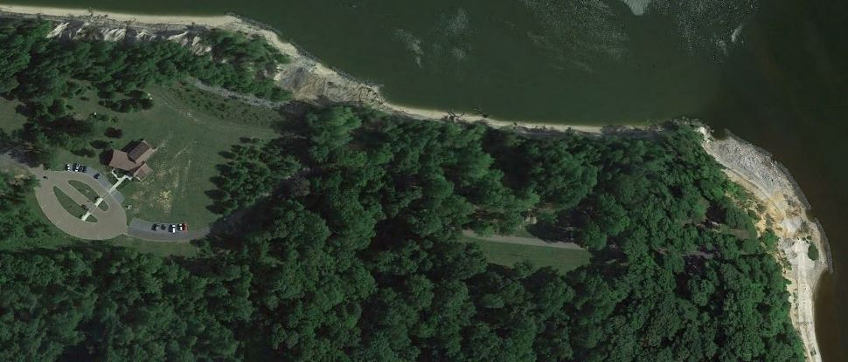
Exterior Survey Supporting Graphics Compound Sketch (Dir. Of Travel, Order of Movement), Annotated Drop Points, Venue Meeting Room, Ingress/Egress, Parking/HLZ, Bunker Array etc…
Description: Big Meadow Trail to Fossil Beach
PICTURES OF EXTERIOR
INCLUDE CAC, DROP POINT, ETC..
HLZ
Grid
18S UH 36765 26336

Slide 13
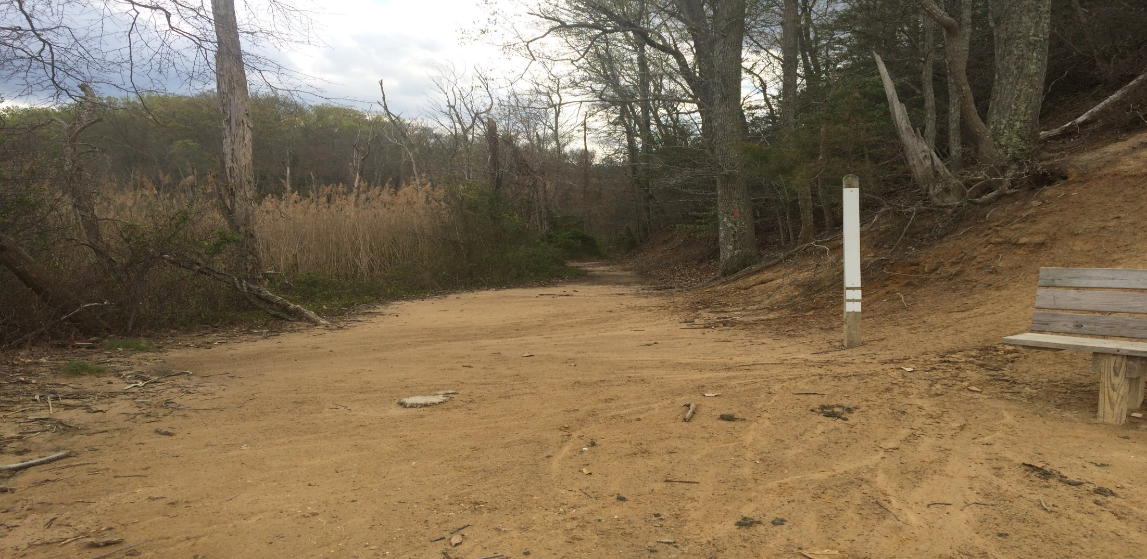
Exterior Survey Supporting Graphics Compound Sketch (Dir. Of Travel, Order of Movement), Annotated Drop Points, Venue Meeting Room, Ingress/Egress, Parking/HLZ, Bunker Array etc…
Description: Big Meadow Trail to Fossil Beach
PICTURES OF EXTERIOR
INCLUDE CAC, DROP POINT, ETC..
HLZ
Grid
18S UH 36765 26336

Slide 14
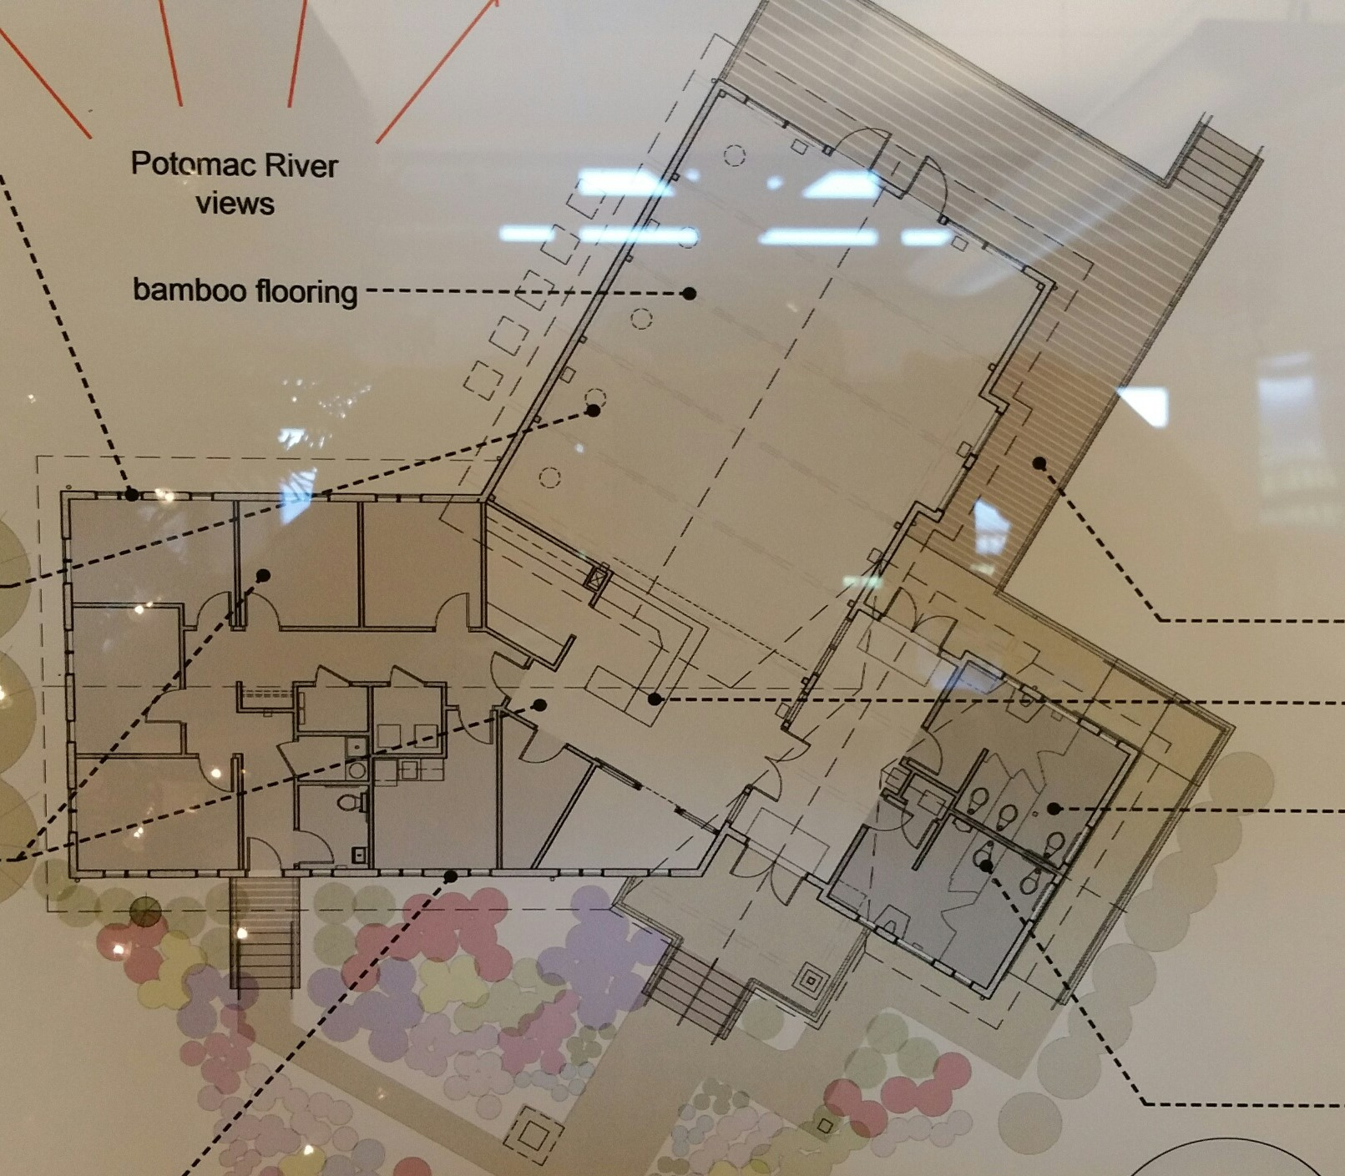
Interior Survey Supporting Graphics Compound Sketch (Dir. Of Travel, Order of Movement), Annotated Drop Points, Venue Meeting Room, Ingress/Egress, Parking/HLZ, Bunker Array etc…
Description:
SKETCH (DRAWING) OF FLOOR PLAN.
FROM DROP POINT, TO MEETING ROOM, TO HARD POINT

Slide 15
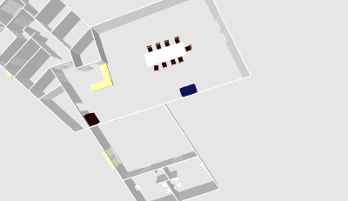
Secondary Entrance
Front Desk
Gift Shop

Slide 16
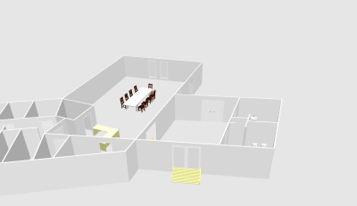
Hard Room
Main Entrance

Slide 17
Meeting Room

Slide 18
Interior Survey Checklist and Addendum to Annotations
Primary Drop Site Description: Strong side drop on the white side /main entrance of the venue
Location:
Alternate Drop Site Description: N/A
Location: N/A
Tertiary Drop Site Description: N/A
Location: N/A
Ancillary Building Description: None
Internal Security Access Requirements (badging, escort, sign in, etc.): No ID’s needed to access the venue.
Terrain and Vegetation: Grassy, Trees, Gravel, Trails
Parking Description (location, size, how many vehicles, etc.): Vehicles may park in linear fashion and parallel to the venue, on the white side, in a graveled area.
Potential HLZs on compound (location, size, etc.): HLZ is located on the red of the venue.
Does the Venue Have Emergency Lighting/Backup Generator: Yes

Slide 19
Interior Survey Primary Building Descriptions for Meeting in Venue
Primary Meeting Room Description (size, occupancy, furniture, etc.): Meeting location is scheduled to be in a large open area with long table and multiple chairs.
Location Description (floor number, etc.): First floor towards the black side (rear) of the venue.
Entrances/Exits (door construction, secured, locks, etc.): The doors to the venue are made of glass and metal.
Windows (numbers, blast protected, observation from outside, etc.): Multiple window surround the venue and are not blast proof.
Nearest Hard Point Description: The men’s room off to the right, just inside the main entrance of the venue (red side).
Location in Reference to Meeting Room: From the meeting location, the hard room is adjacent.
Accommodate How Many Pax: Over ten PAX.
Additional Information:

Slide 20
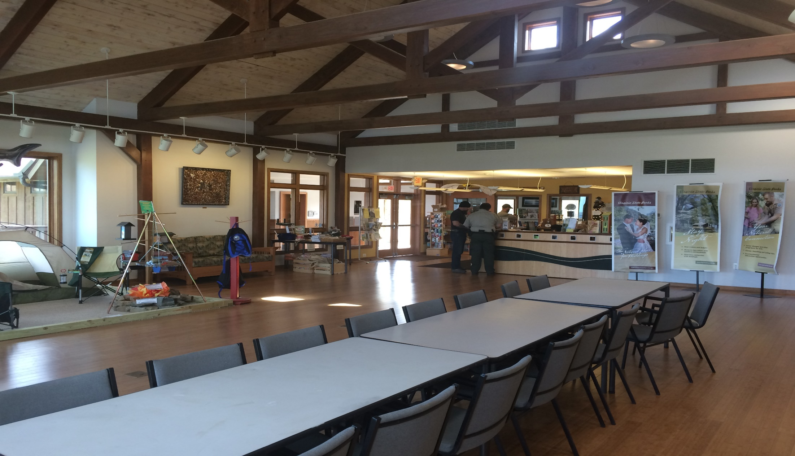
Interior Survey Primary Building Descriptions for Meeting in Venue
Primary Meeting Room Description (size, occupancy, furniture, etc.):
Location Description (floor number, etc.):
Entrances/Exits (door construction, secured, locks, etc.):
Windows (numbers, blast protected, observation from outside, etc.):
Nearest Hard Point Description:
Location in Reference to Meeting Room:
Accommodate How Many Pax:
Additional Information:
Hard Room
Meeting location

Slide 21
Local Security Elements
Guard Force Commander (or Protocol Officer) Name:
Affiliation (MOI, ANA, PSC, etc.): VA State Parks |  | Nationality: American
Languages Spoken: English
Phone Number: | Alternate Phone Number:
Composition of Guard Force: 4 males and 1 female
Level of Search (pat downs, metal detectors, vehicle searches, mirror vehicles, etc.): None
Weapons and Equipment (individual weapons, crew serve, vehicle mounted, etc.): Pistols
Guard Force Uniforms Description: Tannish green shirt, brown pants & duty belts. The security wears a badge on the left side of chest and the uniform shirt has a shoulder patch on each shoulder. They also wear a name tag on the right chest.

Slide 22
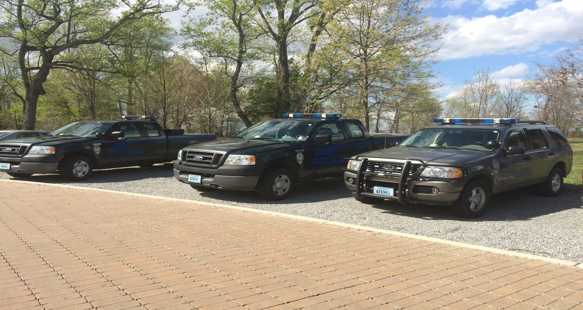
Local Security Elements
Guard Force Commander (or Protocol Officer) Name: Local LE Patrol vehicles
Affiliation (MOI, ANA, PSC, etc.): VA State Parks |  | Nationality: American
Languages Spoken: English
Phone Number: (804) 493-0587 | Alternate Phone Number:
Composition of Guard Force: 4 males and 1 female
Level of Search (pat downs, metal detectors, vehicle searches, mirror vehicles, etc.): None
Weapons and Equipment (individual weapons, crew serve, vehicle mounted, etc.): Pistols
Guard Force Uniforms Description: Tannish green shirt, brown pants & duty belts. The security wears a badge on the left side of chest and the uniform shirt has a shoulder patch on each shoulder. They also wear a name tag on the right chest.
SAMPLE

Slide 23
QUESTIONS??? Please contact us at: 800.605.0914 or Contact@mvxsecuritysolutions.com
SAMPLE

